Slide 1

ZapInnovative
Innovating Today, Transforming Tomorrow.
Premium Technology & Digital Solutions Company Portfolio
ZapInnovative · Technology & Digital Solutions
2026 · Company Portfolio

Slide 2
CONTENTS
01
02
About Us
Our Services
Company overview, vision, mission, and core values
Comprehensive digital solutions for modern businesses
03
04
Why Choose Us
Industries & Portfolio
Our strengths, process, and competitive advantages
Sectors we serve and projects we've delivered
05
06
Technology & Results
Future Vision & Contact
Our tech stack, achievements, and client success stories
Our roadmap and how to connect with us
02 / 16

Slide 3
CHAPTER 01
About Us
Who we are and what drives us forward every day
Chapter 01 / 05

Slide 4
Company Overview, Vision & Mission
04
Company Overview
ZapInnovative is a forward-thinking technology company specializing in digital transformation, web development, mobile apps, branding, and AI-powered solutions.
Our Vision
Our Mission
Core Values
To be the global leader in digital innovation, empowering every business with transformative technology solutions.
To accelerate business growth through innovative technology, exceptional design, and data-driven digital strategies.
■ Innovation
■ Excellence
■ Integrity
■ Collaboration
■ Customer Success
ZapInnovative — Data as of 2026

Slide 5
CHAPTER 02
Our Services
Comprehensive digital solutions tailored for your success
Chapter 02 / 05

Slide 6
Comprehensive Digital Solutions
06
Web Development
E-Commerce
Mobile Apps
Digital Marketing
Branding
Custom, responsive websites built with modern frameworks
Scalable online stores on Shopify, WooCommerce & custom
Native and cross-platform iOS & Android applications
Data-driven campaigns that deliver ROI and growth
Complete brand identity and visual systems
SEO Optimization
Social Media
UI/UX Design
Automation
AI Solutions
Search strategies that increase organic visibility
Engaging content and community management
User-centered design for exceptional experiences
Streamline operations with intelligent automation
Leverage AI for business innovation
Need a custom solution? Let's discuss your project
We tailor our services to match your unique business requirements and growth objectives.
ZapInnovative — Services Overview 2026

Slide 7
CHAPTER 03
Why Choose Us
Our competitive edge and proven methodology
Chapter 03 / 05

Slide 8
8 Reasons to Partner With ZapInnovative
08
Innovation-Driven
Experienced Team
Customized Solutions
Modern Tech Stack
We stay ahead of technology trends to deliver cutting-edge solutions.
50+ experts across development, design, and digital strategy.
Tailored to your unique business needs and growth objectives.
Latest frameworks and tools for optimal performance.
Fast Delivery
Scalable Solutions
Customer-Centric
End-to-End Support
Agile methodology for rapid deployment and iteration.
Built to grow with your business at every stage.
Your success is our priority. We measure by results.
From concept to post-launch maintenance and beyond.
Ready to transform your business?
Partner with ZapInnovative and experience the difference of working with industry leaders.
ZapInnovative — Why Choose Us

Slide 9
Our Proven 7-Step Process
09
01
02
03
04
05
06
07
Discovery
Strategy
Design
Development
Testing
Launch
Support
Understand your goals, audience, and requirements through in-depth research and analysis.
Define roadmap, tech stack, and milestones aligned with business goals.
Create stunning UI/UX with wireframes, prototypes, and visual design systems.
Build with clean code, modern frameworks, and agile sprints for rapid progress.
Rigorous QA, performance testing, and cross-platform compatibility checks.
Seamless deployment with monitoring, analytics setup, and go-live support.
Ongoing maintenance, updates, and optimization to ensure long-term success.
Agile. Transparent. Results-Driven.
Weekly sprints · Real-time updates · Direct communication · Zero surprises
ZapInnovative — Our Process

Slide 10
CHAPTER 04
Industries & Portfolio
Trusted across industries. Proven results that speak for themselves.
Chapter 04 / 05

Slide 11
Industries We Serve
11
Healthcare
Education
E-Commerce
Real Estate
Digital health platforms and patient engagement solutions
E-learning platforms and institutional digital transformation
Online retail solutions and marketplace development
Property platforms and digital marketing for brokers
Hospitality
Finance
Startups
Corporate
Booking systems and guest experience platforms
Fintech solutions and secure payment systems
MVP development and growth hacking strategies
Large-scale digital transformation projects
Industry Reach
Industries Served
Projects Delivered
ZapInnovative — Industry Coverage 2026

Slide 12
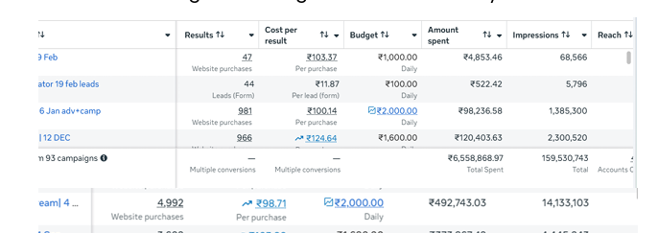
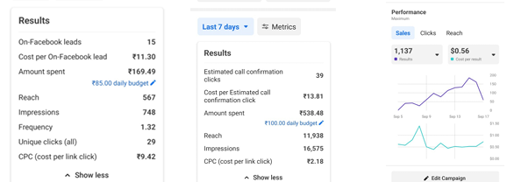
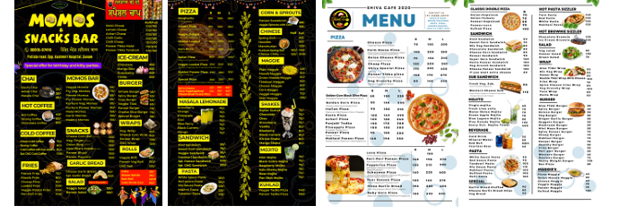
Portfolio Showcase — Real Results
12
Digital Marketing Campaigns — Real Customer Projects
Social Media Ads — High-ROI Performance
Campaign Performance
₹4-5L
1,137
Monthly Ad Budget Managed
Results at $0.56 per result
159M+
200+
Creative Design — Branding & Visual Assets
Total Impressions Delivered
Projects Delivered
From concept to conversion — We deliver measurable results across digital marketing, creative design, and development.
ZapInnovative — Portfolio Showcase 2026

Slide 13
CHAPTER 05
Technology & Results
Modern tech stack. Measurable results. Proven impact.
Chapter 05 / 05

Slide 14
Our Technology Stack — Built for the Future
14
FRONTEND
HTML5
CSS3
JavaScript
React
BACKEND
PLATFORMS
Node.js
PHP
Python
WordPress
Shopify
MOBILE
AI & TOOLS
Flutter
Cloud
AI/ML Tools
We continuously evaluate and adopt emerging technologies to keep our clients ahead.
Always Evolving

Slide 15
Results, Achievements & Client Stories
15
Client Testimonials
ZapInnovative transformed our digital presence completely. Our online revenue increased by 180% within 6 months.
The team's expertise in AI integration helped us automate 70% of our customer support operations.
Professional, responsive, and incredibly talented. They delivered our mobile app 2 weeks ahead of schedule.
CEO, E-Commerce Brand
CTO, SaaS Company
Founder, HealthTech Startup
★★★★★
★★★★★
★★★★★
Empowering Businesses Through Innovation
Technology, and Digital Excellence.
ZapInnovative — Client Results & Testimonials

Slide 16

Let's Build the Future Together
Our Future Vision
AI Integration — Leading the AI revolution in business solutions
Global Expansion — Serving clients across 30+ countries by 2028
Digital Transformation Leadership — Pioneering next-gen solutions
Innovation-Focused Growth — 500+ projects and 100+ team members
Get In Touch
Follow Us
■ zapinnovative.com
■ LinkedIn
■ hello@zapinnovative.com
■ Twitter / X
■ +91-XXXXXXXXXX
■ Instagram
Innovating Today, Transforming Tomorrow.
ZapInnovative · 2026 · All Rights Reserved

